Slide 1
Richter’s Predictor: Modeling Earthquake Damage
David Gagliardi

Slide 2
Outline of Presentation
Introduction
Dataset
Objectives/Motivations
Related Work
Proposed Work and Results
Q & A
Notes:
David

Slide 3
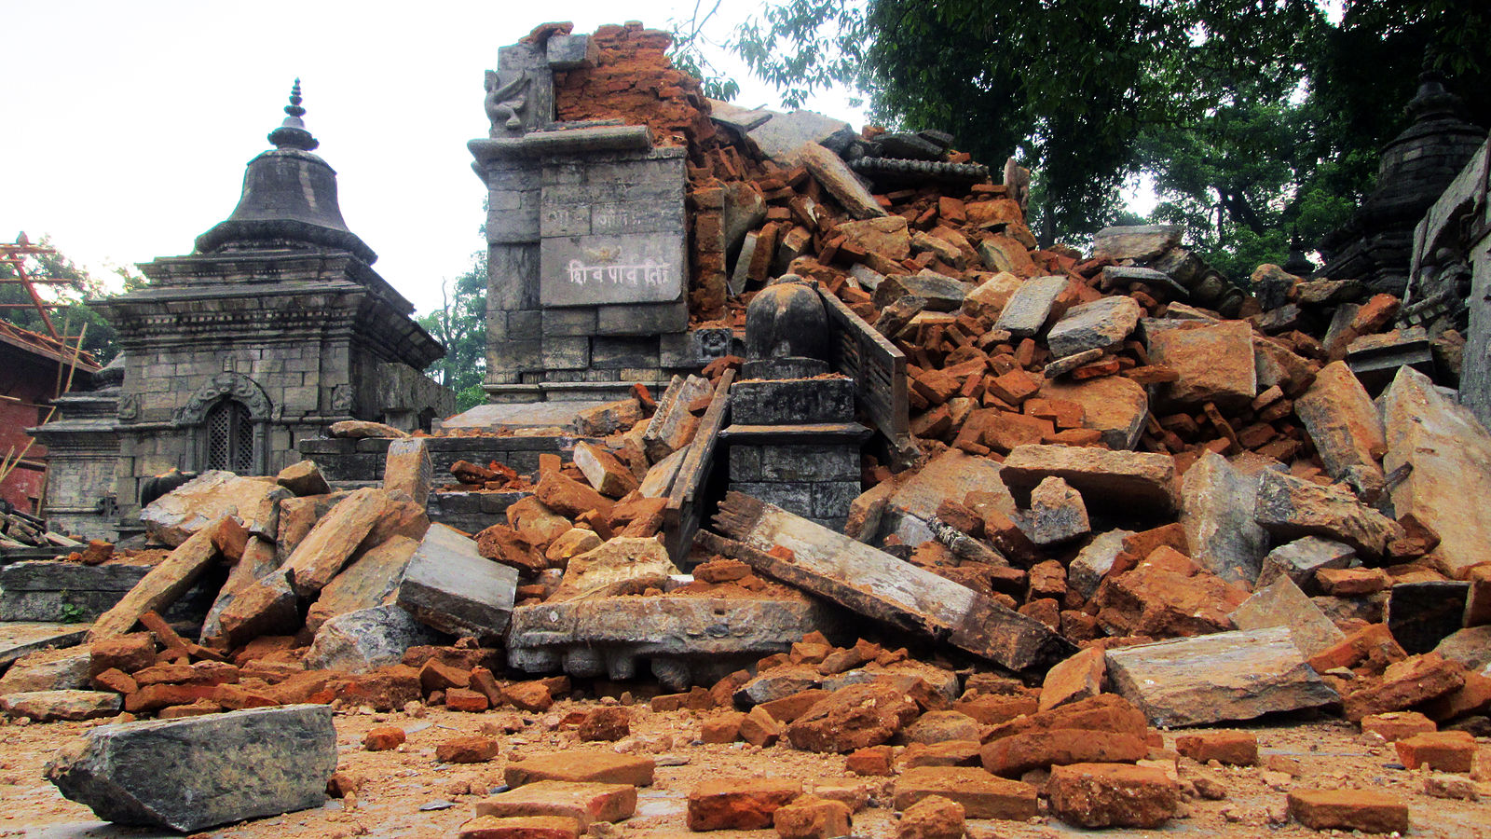
Introduction
Website: drivendata.org
Competition: Richter's Predictor: Modeling Earthquake Damage
Based on data about a building location and structure, predict the level of damage of the building after an earthquake, specifically, the 2015 Gorkha earthquake in Nepal
1 - low damage
2 - medium amount of damage
3 - almost complete destruction
An image depicting an example of damage caused by the 2015 earthquake in Nepal. Wikimedia Commons.https://upload.wikimedia.org/wikipedia/commons/6/64/2015_Earthquake_in_Nepal-Pashupatinath_Temple_Area_(12).JPG.
Notes:
Jordan

Slide 4
Dataset
Gathered by surveyors and surveying technology in Nepal following a 7.8 Mw earthquake in 2015, originally used to identify beneficiaries for government relief
Made up out of details about building structures and ownership, such as…
Geographic regions, floor count, foundation type, age, materials used, and uses (i.e. school, residency, agriculture, government, etc.), and more
Size of the data given
38 features/attributes, 260,000 rows for training, 87,000 rows for training
Three files: train_values.csv (23.4 MB), train_labels.csv (2.3 MB), test_values.csv (7.8 MB)
Notes:
Jordan

Slide 5
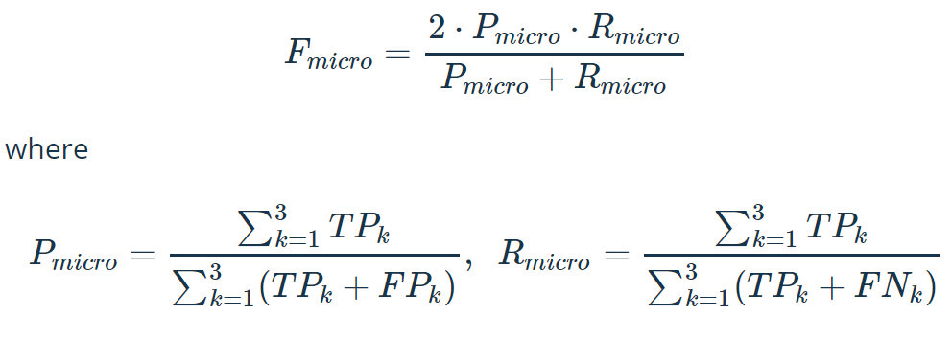
Objectives
Place within the top 50 competitors in the Driven Data competition modeling earthquake damage.
Currently at 5570 competitors
Compare different machine learning models, specifically K-Means Clustering, Neural Networks, and Ensemble Learning to gain insight of the best approach to model our given type of data.
Using the micro averaged F1 score

Slide 6
Motivations and Related Work
Rationale for choosing and implementing these algorithms are as follows:
K-Means Clustering works well for globular datasets and I expect buildings that are globbed together in similar geo-locations to have similar damage grades (Tan et al., 549).
Deep Learning works well for classification as it can pick up on and learn non-intuitive patterns, reducing the need for complex feature engineering, (Sestelli, 2018).
Ensemble learning methods have the ability to decrease the variances and biases of base models as well as improve upon the overall accuracy and predictive power through meta learners.
Research on the ability to quickly and accurately predict the severity of building damage is essential to emergency response and societal recovery(Mangalathu, Sujith, et al. 2020).
Visually determining and classifying damage post earthquake can be a slow and resource heavy procedure(Mangalathu, Sujith, et al. 2020).
By developing models that can rapidly and accurately predict building damage, societies can better prepare and recover from these traumatic disasters(Mangalathu, Sujith, et al. 2020).

Slide 7
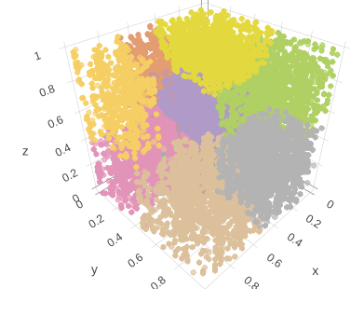
K- Nearest Neighbors
Rationale:
Clustering methods are well suited to geo-spatial data.
3D Cluster generated from
3 strongest predictors

Slide 8
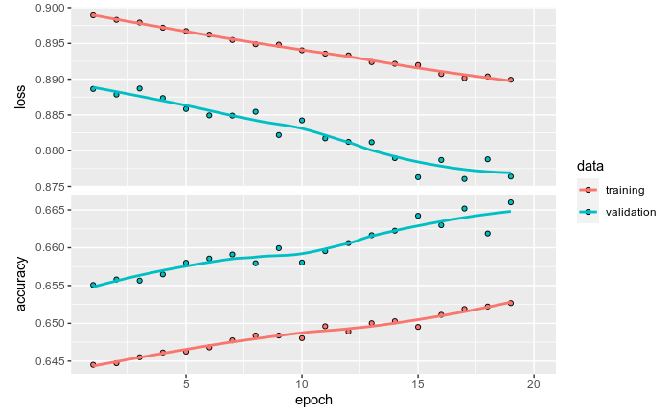
Deep Learning - Results
Overfitting occurred.
Too many nodes, too many layers, bad activation, bad optimizer, wrong batch size, etc.
Best micro averaged F1 score - 0.6631
The accuracy and loss measures of the final model during training.

Slide 9
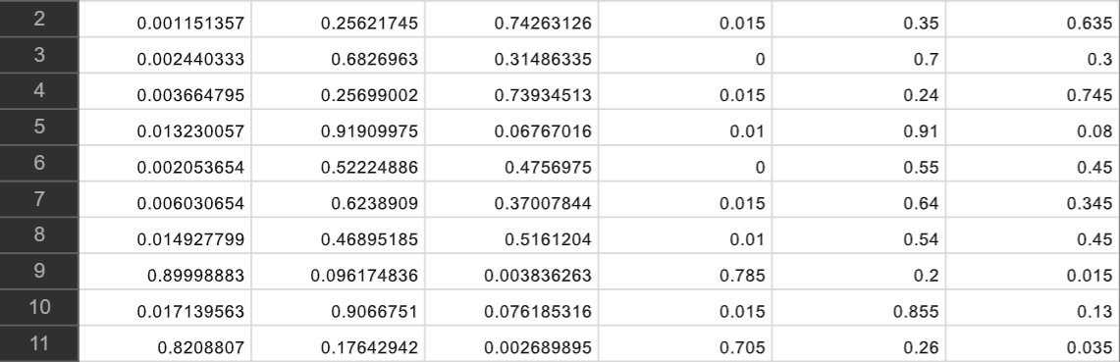
Ensemble
Final model is actually an “ensemble of ensembles” wherein I used the two best performing ensemble classifiers to generate a stacked dataset that is then used to train the meta classifier to make predictions.
Base Learners:
Gradient Boosting Decision Tree Classifier
Bagging Classifier of 25 K-Nearest Neighbors
Meta Learner
AdaBoost of 800 Decision Stumps
I tuned each model by using 5 fold grid search cross validation
25% of the Training data was set aside for evaluation using the micro averaged F1 score
Stacked dataset example

Slide 10
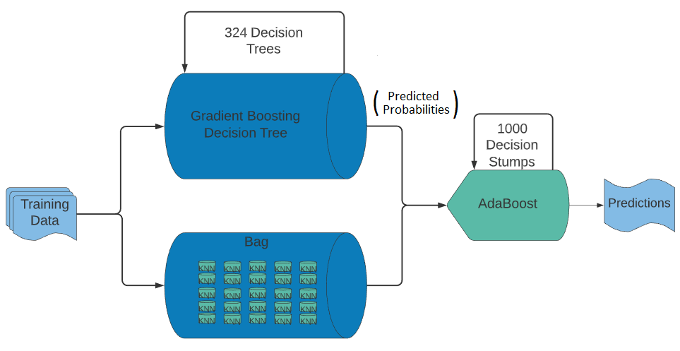
Ensemble - Structure
Training Data is used as input into our two base classifiers
Gradient Boosting Decision Tree
Bagging of 25 K-Nearest Neighbors
Each classifier then outputs the predicted probabilities of the 3 classes
The probabilities are then stacked and used as training data for our meta learner
AdaBoost Classifier of 1000 Decision Stumps
The meta learner outputs the final predictions
Generalized visualization of our final ensemble

Slide 11
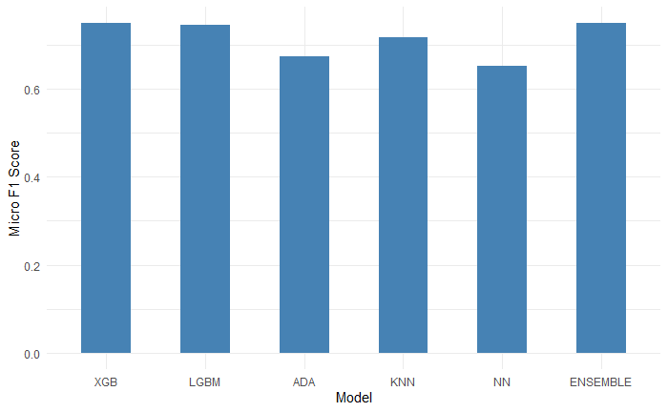
Ensemble - Results
Models performed similarly across the board.
Micro Averaged F1 Scores:
XGB - 0.74915
LGBM - 0.74522
ADA - 0.67397
KNN - 0.71740
NN - 0.65247
Ensemble – 0.7529
Our final ensemble performed better than the runner up model, XGB, by a micro averaged F1 score of 0.00375
Our ensemble outperformed our worst performing model, Neural Network, by roughly 0.1
Micro averaged F1 scores on train test split dataset

Slide 12
Conclusions
Strongest predictors were geospatial data, however every feature had some positive predictive power.
Globular data helped K-Nearest Neighbors to converge quickly and find relevant clusters.
Lead to incorporation of K-Nearest Neighbors in the final ensemble.
Dataset was too small/not complex enough to properly model using deep learning.
Lead to utilization of decision trees, as they tend to be simpler models to understand, tune, and train.
Ensemble learning performed the best in this competition where even the worst performing ensemble scored a 0.0159 higher micro averaged F1 score than the best performing non-ensemble method.

Slide 13
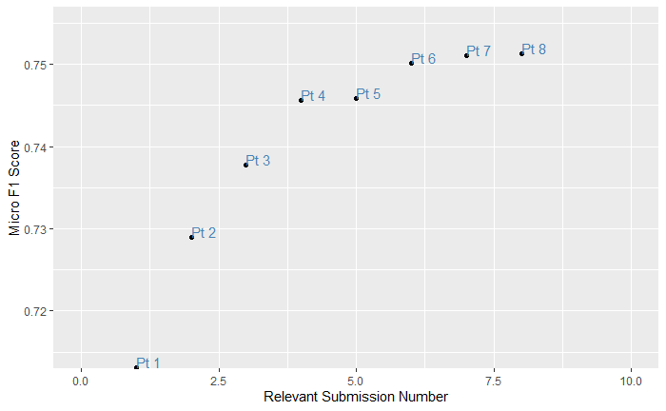
Competition Results
Point | Model | Micro F1 Score
Pt 1 | K-Nearest Neighbors | 0.7131
Pt 2 | Random Forest | 0.7290
Pt 3 | Stacked Classifier of RF and KNN | 0.7378
Pt 4 | XGB | 0.7456
Pt 5 | Stacked Classifier of XGB and KNN | 0.7459
Pt 6 | Re Optimized XGB | 0.7502
Pt 7 | Re Optimized Stacked Classifier | 0.7511
Pt 8 | Final Stacking Architecture | 0.7529
Micro averaged F1 scores of our competition entries

Slide 14
Final Results...
Best performing Ensemble achieved a micro averaged F1 score of 0.7529
Currently sitting in 17th place!

Slide 15
Sources Cited
Dietterich, Thomas. “Ensemble Learning.” Ensemble Learning, 2002, courses.cs.washington.edu/courses/cse446/12wi/tgd-ensembles.pdf.
DrivenData. “Richter's Predictor: Modeling Earthquake Damage.” DrivenData, 2019, www.drivendata.org/competitions/57/nepal-earthquake/page/134/.
Jain, Aarshay, et al. “Complete Guide to Parameter Tuning in XGBoost (with Codes in Python).” Analytics Vidhya, 13 Sept. 2019, www.analyticsvidhya.com/blog/2016/03/complete-guide-parameter-tuning-xgboost-with-codes-python/.
Kiri Wagstaff, Claire Cardie, Seth Rogers, and Stefan Schrödl. 2001. Constrained K-means Clustering with Background Knowledge. In Proceedings of the Eighteenth International Conference on Machine Learning (ICML ’01). Morgan Kaufmann Publishers Inc., San Francisco, CA, USA, 577–584. https://web.cse.msu.edu/~cse802/notes/ConstrainedKmeans.pdf
Mangalathu, Sujith, et al. “Classifying Earthquake Damage to Buildings Using Machine Learning - Sujith Mangalathu, Han Sun, Chukwuebuka C. Nweke, Zhengxiang Yi, Henry V. Burton, 2020.” SAGE Journals, journals.sagepub.com/doi/abs/10.1177/8755293019878137?journalCode=eqsa.
Sapkota, Nabin K. “Destruction of Dewal at Pashupatinath Temple Area during 2015 Earthquake in Nepal.” Wikimedia Commons, Self, 25 Apr. 2015, https://upload.wikimedia.org/wikipedia/commons/6/64/2015_Earthquake_in_Nepal-Pashupatinath_Temple_Area_(12).JPG.
Sestilli, Carson. “Insights - Software Engineering Institute.” Insights - Software Engineering Institute, Carnegie Mellon University, 12 Feb. 2018, https://insights.sei.cmu.edu/sei_blog/2018/02/deep-learning-going-deeper-toward-meaningful-patterns-in-complex-data.html.
Schmidhuber, Jürgen. “Deep Learning in Neural Networks: An Overview.” Neural Networks, vol. 61, 2015, pp. 85–117., doi:10.1016/j.neunet.2014.09.003.
Scikit-learn developers. “Examples.” Scikit, 2019, scikit-learn.org/stable/auto_examples/index.html.
Scikit-learn developers. “User Guide.” Scikit, 2019, scikit-learn.org/stable/user_guide.html.
Tan, Pang-Ning, et al. Introduction to Data Mining. 2nd ed., Pearson, 2019.
P. Yang and B. Huang, "KNN Based Outlier Detection Algorithm in Large Dataset," 2008 International Workshop on Education Technology and Training & 2008 International Workshop on Geoscience and Remote Sensing, Shanghai, 2008, pp. 611-613.

Slide 16
Questions?

